Slide 1
PROJECT TITLE
IBM HACKATHON PROJECT
Presented By: Harish Chandra Mohanta
College Name : VSSUT, BURLA
Department : Computer Science and Engineering

Slide 2
OUTLINE
Problem Statement
Technology used
Wow factor
End users
Result
Conclusion
Git-hub Link
Future scope
IBM Certifications

Slide 3
Problem Statement
The objective of this project is to predict whether a customer will default on their credit card payment based on various factors such as past payment behavior, credit limit, and demographics. This predictive model aids financial institutions in risk assessment and decision-making by estimating the probability of default rather than just a binary classification (default or not default)

Slide 4
Technology used
IBM Cloud Services:
IBM Watson Studio (for building and training models)
IBM AI Runtime Services (for model execution)
Machine Learning Models Used:
Snap Random Forest Classifier
XGBoost Classifier (HPO & FE optimizations)
Libraries & Tools:
Python, Jupyter Notebook
Scikit-learn, Pandas, NumPy, Matplotlib, Seaborn
Evaluation Metrics:
Accuracy, Precision-Recall, F1 Score, K-S Chart

Slide 5
IBM cloud services used
IBM Watson Studio:
Used for building, training, and evaluating machine learning models.
IBM AI Runtime Services:
Provides execution support for deployed models.
IBM Cloud Pak for Data (Optional):
Enables end-to-end data science lifecycle management.
IBM AutoAI:
Automatically compares different ML pipelines and selects the best model.

Slide 6
Wow factors
Deployed on IBM Watson Studio – Leveraging IBM cloud services for AI-powered model training and evaluation.
Automated Pipeline Comparison – Multiple model pipelines tested to find the best performing classifier.
Hyperparameter Optimization (HPO) – Enhanced model accuracy using fine-tuned parameters.
K-S Chart Analysis – A unique evaluation metric to assess the separation between defaulters and non-defaulters.

Slide 7
End users
Banks & Financial Institutions – Credit risk assessment and fraud detection.
Loan Providers – To determine loan eligibility and default probability.
Data Scientists & Analysts – To build and optimize credit scoring models.

Slide 8
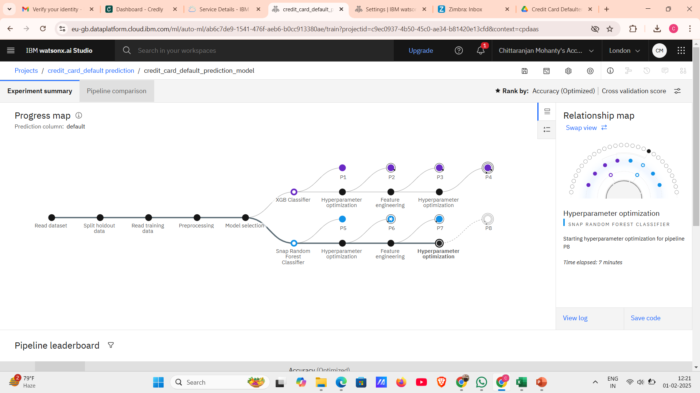
Results

Slide 9
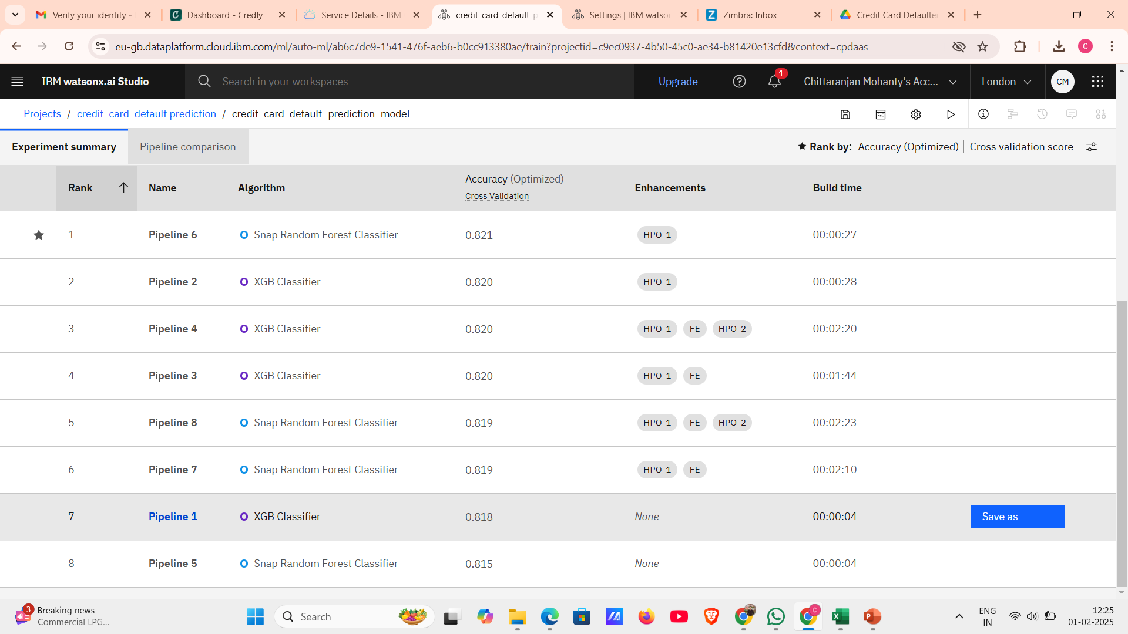
Results

Slide 10
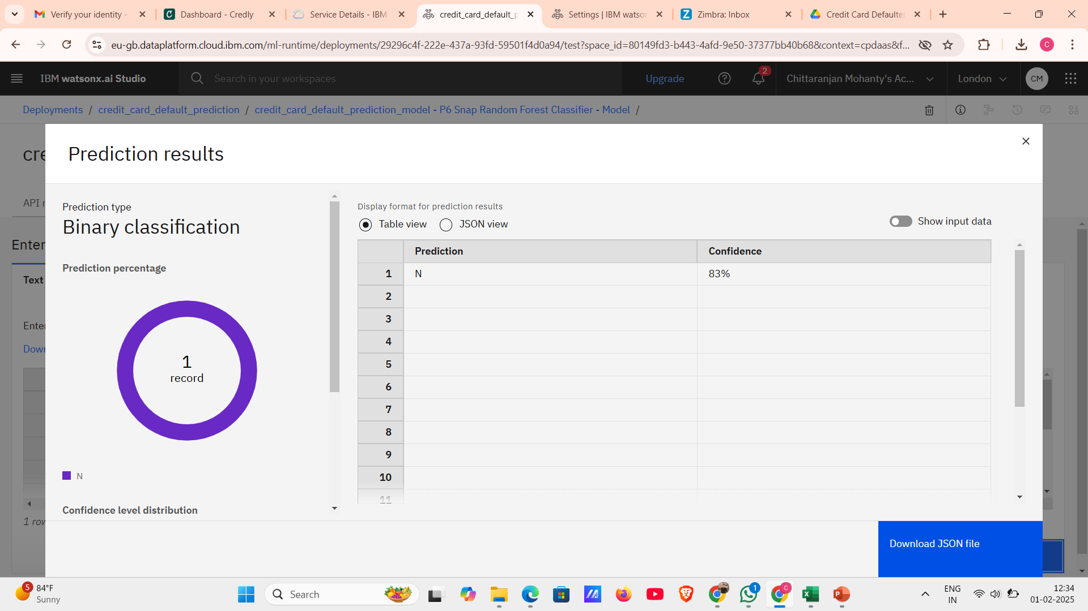
Results

Slide 11
Conclusion
The project successfully predicts credit card default risk using IBM Watson Studio and AI Runtime Services. Multiple machine learning pipelines were tested, with the Snap Random Forest Classifier achieving the highest accuracy of 82.1%. The integration of hyperparameter tuning (HPO) further improved model performance. This approach enhances credit risk assessment, providing valuable insights for financial institutions

Slide 12
GitHub Link
https://github.com/Harish-Mohanta2003/Credit-card-Default-Prediction

Slide 13
Future scope
Deployment as an IBM Cloud API – Integrating the trained model into financial applications.
Real-Time Data Processing – Implementing a streaming model for live credit risk monitoring.
Deep Learning Models – Experimenting with neural networks for better accuracy.
Enhanced Interpretability – Using SHAP values to explain model predictions.

Slide 14
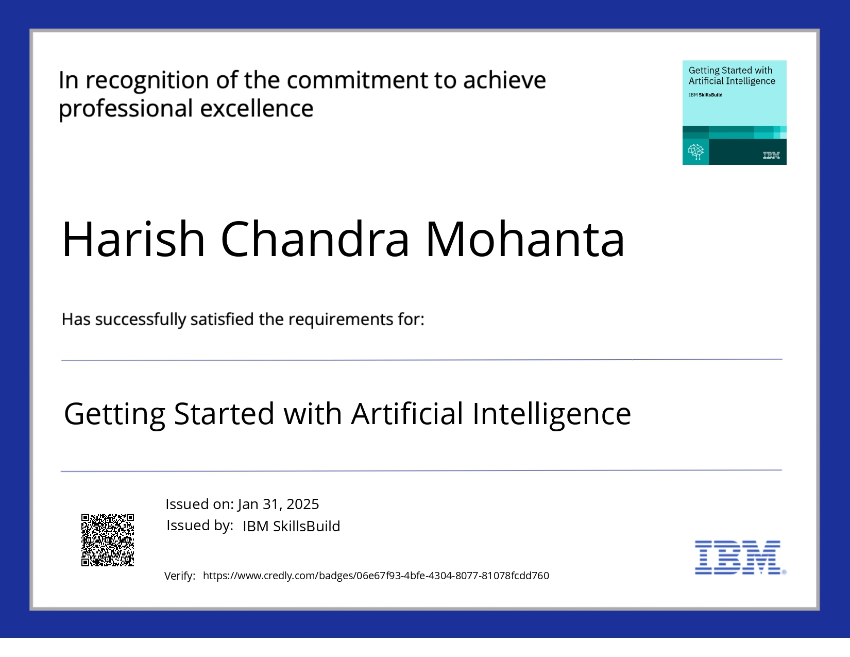
IBM Certifications

Slide 15
THANK YOU

